Slide 1

Role of kinases MAP2K1, PDHK and NEK1 on Hedgehog Signaling Activation
Paige Halas
Atwood Lab Rotation Wrap Up
December 6, 2019

Slide 2
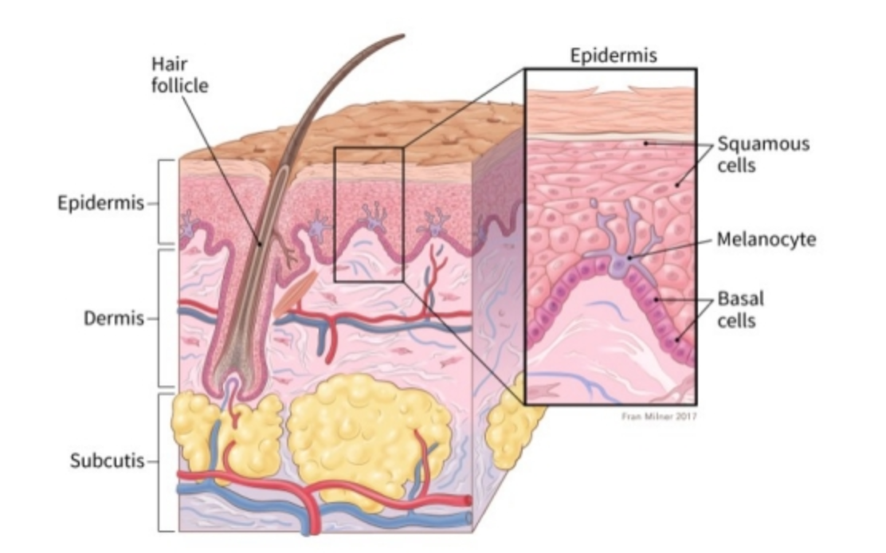
Basal Cell Carcinoma
Annual Skin Cancer Diagnosis in the US
American Cancer Society
Notes:
Basal Cell Carcinoma is the most prevalent skin cancer in the US with 4 million diagnosis a year. This cancer occurs in the basal layer which is the lowest layer of the epidermis and is most common on sun-exposed areas of the body. This disease is deadly if left untreated and is has a particularly high rate of reoccurrence which adds to its risk to the patient. Evidence supports that BCC caused by uncontrolled activation of the hedgehog signaling pathway which is critical in development in the primary cilia of a cell.

Slide 3

Hedgehog Signaling Pathway
Atwood et al., 2012
Notes:
Inactive Hh pathway and B. active Hh pathway
Inactive HH pathway, Patched receptor inhibits smoothened and Sufu inhibits Gli transcription pathway
When HH ligand binds to patched receptor activating the signal transducer Smoothened (SMO). SMO then moves to the cilium where it binds and inhibits Suppressor of Fused (SUFU), resulting in transcription factor activation of Glioma-Associated Oncogene (GLI)

Slide 4
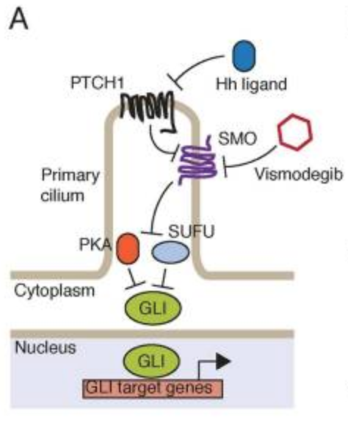
Inhibition of SMO to treat BCC
Sharpe et al., 2015

Slide 5

Inhibition of SMO to treat BCC
Sharpe et al., 2015
Notes:
As a method for treating BCC, small molecule drugs such as vismodegib have been designed to inhibit smoothened. When smoothened is inhibited, the release of GLI transcription factors cannot occur and thus Hedgehog target genes cannot be transcribed. However, it has been found that BCC can acquire resistance to SMO inhibitors thus causing a loss of SMO inhibitor Sufu or the gain of more transcription factors in the system. Additionally, mutations in SMO have caused the drug to be ineffective in suppressing SMO and thus allowing the pathway to proceed as normal.

Slide 6
Alternative Target for BCC Treatment
Kinase
Regulated
Notes:
Both BCC resistance and SMO mutations have directed the attention in drug development to the GLI transcription factors. Our lab has compiled and screened for activation of mutations in GLI that are recurrent in the COSMIC database. It is believed that transcription factors are regulated by kinases; therefore, it is of interest to see the effect of kinase activity on these mutation sites.

Slide 7
Purpose
- Assess activation of the Hedgehog Signaling Pathway by kinases predicted to phosphorylate recurrent GLI mutation sites
Hypothesis
- MAP2K1/MEK1, PDHK and NEK1 which have been predicted to phosphorylate GLI mutation sites will cause activation of Hedgehog Signaling
Notes:
Kinases predicted to be active at recurrent GLI mutations were selected based on previous insight into their activity in Hedgehog Signaling or cancer allowed. Additionally inhibitors for these kinases were selected based on their availability, specificity and IC50 range.

Slide 8
Inhibition of SMO to treat BCC
Kinase
Regulated
Sharpe et al., 2015

Slide 9
Kinases Predicted to be Active at Recurrent GLI Mutations
Kinase | Significance | Inhibitor
Mitogen-Activated Protein Kinase 2 (MAP2K1/MEK1) | Melanoma and metastasis Stabilizes GLI and activates Hedgehog Signaling | Cobimetinib IC50 4.2 nM
Pyruvate Dehydrogenase Kinase (PDHK) | Regulates glycolysis Inhibition upregulates apoptosis | Dichloroacetic Acid IC50 81.03 mM
NIMA Related Kinase (NEK1) | Role in ciliogenesis Activates GLI and Hedgehog Signaling | Zinc05007751 IC50 3.4 μM
Notes:
Kinases predicted to be active at recurrent GLI mutations were selected based on previous insight into their activity in Hedgehog Signaling or cancer allowed. Additionally inhibitors for these kinases were selected based on their availability, specificity and IC50 range.

Slide 10


MAP2K1/MEK1 inhibition does not impact Hedgehog Signaling Activation
Wild Type (3T3)
BCC
Notes:
Gli expression of RNA extracted from WT and BCC cells treated with drug for 24 hours.
Looking at GLI gene expression indicative of Hedgehog Pathway activation. We observe increased Gli expression in hedgehog conditioned serum starved media as expected because the Hedgehog pathway is specifically activated. However, between untreated and treated samples, not much change in GLI expression.
Outlier BCC (still outlier that whatever happened in that treatment condition Is just odd but with an experimental replicate it could go away, could also be a bimodal response where there is a different response to the drug based on its concentration)

Slide 11
MAP2K1/MEK1 inhibition does not impact Hedgehog Signaling Activation
Wild Type (3T3)
BCC
**MTT assay shows no impact on Cell Proliferation**
Notes:
We observe increased Gli expression in hedgehog conditioned serum starved media as expected because the Hedgehog pathway is specifically activated.
Outlier BCC (repeating experiment)

Slide 12
MAP2K1/MEK1 Affects Cell Proliferation at High Concentrations of Cobimetinib Inhibitor
Notes:
Measuring absorbance at 570 nM as a measure of BCC cell viability when treated with drug.
Comparing the blue line (diluent only) to the other lines we do not see significant change in the absorbance at 570 nM with the exception of the 100 nM concentration during the last day of incubation. Overall, do not see a significant effect on the cell viability for BCC cells when treated with inhibitor
BCC not the best to do this with because they have developed resistance over time, but if we wanted to look at general cytotoxicity would use a mouse Keratinocyte line but because no real effect in BCCs, no need to look at the general cytotoxicity.

Slide 13
Kinases Predicted to be Active at Recurrent GLI Mutations
Kinase | Significance | Inhibitor
Mitogen-Activated Protein Kinase 2 (MAP2K1/MEK1) | Melanoma and metastasis Stabilizes GLI and activates Hedgehog Signaling | Cobimetinib IC50 4.2 nM
Pyruvate Dehydrogenase Kinase (PDHK) | Regulates glycolysis Inhibition upregulates apoptosis | Dichloroacetic Acid IC50 81.03 mM
NIMA Related Kinase (NEK1) | Role in ciliogenesis Activates GLI and Hedgehog Signaling | Zinc05007751 IC50 3.4 μM
Notes:
MAP2K1/MEK does not seem to have effect on Hedgehog Signaling pathway, so we can eliminate this kinase from our running
Next look at PDHK and why

Slide 14


Inhibition of PDHK by Dichloroacetic Acid does not reduce Hedgehog Signaling
Wild Type (3T3)
BCC
Notes:
See small increase in hedgehog treated 3T3 cells but at IC50 of 80 mM the Gli expression is low
BCC does not show much change with presence of inhibitor.

Slide 15
Inhibition of PDHK by Dichloroacetic Acid does not reduce Hedgehog Signaling
Wild Type (3T3)
BCC
**MTT assay shows no impact on Cell Proliferation**
Notes:
See small increase in hedgehog treated 3T3 cells but at IC50 of 80 mM the Gli expression is low
BCC does not show much change with presence of inhibitor.

Slide 16
Treatment of BCC cells with PDHK inhibitor Dichloroacetic Acid does not affect cell survival
Notes:
Measuring absorbance at 570 nM as a measure of BCC cell viability when treated with drug.
Comparing the blue line (diluent only) to the other lines we do not see significant change in the absorbance at 570 nM. Overall, do not see a significant effect on the cell viability for BCC cells when treated with inhibitor

Slide 17
Kinases Predicted to be Active at Recurrent GLI Mutations
Kinase | Significance | Inhibitor
Mitogen-Activated Protein Kinase 2 (MAP2K1/MEK1) | Melanoma and metastasis Stabilizes GLI and activates Hedgehog Signaling | Cobimetinib IC50 4.2 nM
Pyruvate Dehydrogenase Kinase (PDHK) | Regulates glycolysis Inhibition upregulates apoptosis | Dichloroacetic Acid IC50 81.03 mM
NIMA Related Kinase (NEK1) | Role in ciliogenesis Activates GLI and Hedgehog Signaling | Zinc05007751 IC50 3.4 μM
Notes:
PDHK does not seem to be a promising target, however we could try to increase the range of drug treatment to see if there is an impact. However, the inhibitor we are using is a general acid so many different pathways might be impacted with the use of this drug. If we wanted to pursue this kinase we could knock out PDHK with short hairpin RNA or CRISPR to see if the drug is working specifically on its target and how its working.
Then look at the next kinase (NEK)

Slide 18


Inhibition of NEK1 affects Hedgehog Signaling Activation
Wild Type (3T3)
BCC
Notes:
See increase in expression of HH SS WT but see a reduction of the GLI expression when the drug is added. In the BCC cell line, we see some concentrations have decreased GLI expression, which is a positive result.

Slide 19
Inhibition of NEK1 affects Hedgehog Signaling Activation
Wild Type (3T3)
BCC
**MTT assay shows no impact on Cell Proliferation**

Slide 20
Treatment of BCC cells with NEK1 inhibitor Zinc05007751 does not affect cell survival
Notes:
Measuring absorbance at 570 nM as a measure of BCC cell viability when treated with drug.
Comparing the blue line (diluent only) to the other lines we do not see significant change in the absorbance at 570 nM. Overall, do not see a significant effect on the cell viability for BCC cells when treated with inhibitor

Slide 21
Kinases Predicted to be Active at Recurrent GLI Mutations
Kinase | Significance | Inhibitor
Mitogen-Activated Protein Kinase 2 (MAP2K1/MEK1) | Melanoma and metastasis Stabilizes GLI and activates Hedgehog Signaling | Cobimetinib IC50 4.2 nM
Pyruvate Dehydrogenase Kinase (PDHK) | Regulates glycolysis Inhibition upregulates apoptosis | Dichloroacetic Acid IC50 81.03 mM
NIMA Related Kinase (NEK1) | Role in ciliogenesis Activates GLI and Hedgehog Signaling | Zinc05007751 IC50 3.4 μM
Notes:
NEK Kinase seems to be the most impactful of the kinases tested, as presence of the inhibitor caused a reduction in GLI expression, thus suppressing GLI activation and showing NEK1 is important in this pathway

Slide 22
Future Directions
Continue Pursuit of NEK1 as Hedgehog Signaling Activator
Short Term Experiments
Increase exposure to SS/HH SS conditions
Increase range of Zinc05007751
Cytotoxicity control
Confirm target of Zinc05007751 by knocking down NEK1
Long Term Experiments
Investigate if Hedgehog is being activated through GLI through knock down
Determine how GLI is being activated by NEK1
Screen a larger amount of kinases for their activity on the Hedgehog Signaling Pathway
Notes:
Moving forward, I would like to continue to pursue NEK1 as a Hedgehog Signaling Pathway activator. To begin, I would increase the incubation of cells in SS conditions. These cells were placed in SS conditions right before dosing, however, I would like to confirm that this interaction still occurs when the cells are serum starved for a day before treatment. This would likely increase the response we have observed in the Wild Type cells because the primary cilia would have time to form. I would increase the range of Zinc05007751 tested as the range in this experiment was narrow beginning with 3.4 uM and increasing to 10 uM. This will give us a better idea of the effect of this drug. Additionally, I want to provide a control for cytotoxicity by treating a mouse keratinocyte line with the drug and incubating for 6 days. This is crucial because the BCC cell line has gained resistance over time so we want to have a mimic for what this drug will do in vivo in a mouse experiment. After fine tuning these experimental conditions, I would like to confirm that the target for this drug is as expected by knocking down NEK1 using shRNA or CRISPR. I expect that the drug will not have an effect on GLI transcription when NEK1 is knocked down as it will not be able to act on its target.
Long term want to investigate if the Hedgehog pathway is being activated by Gli by knocking down GLI with ShRNA or CRISPR and treating with NEK inhibitor to and measuring the GLI expression.

Slide 23
Future Directions
Increase exposure to SS/HH SS Conditions
Increase range of Inhibitor
Continue Kinase Screening
Cytotoxicity control
Confirm inhibitor target
Confirm NEK1 as Activator of HH Signaling
Investigate GLI Activation by NEK1
BUB1, PAK6, CDK19
GLI Activation with qPCR
Cell Survival
Notes:
Moving forward, I would like to continue to pursue NEK1 as a Hedgehog Signaling Pathway activator. To begin, I would increase the incubation of cells in SS conditions. These cells were placed in SS conditions right before dosing, however, I would like to confirm that this interaction still occurs when the cells are serum starved for a day before treatment. This would likely increase the response we have observed in the Wild Type cells because the primary cilia would have time to form. I would increase the range of Zinc05007751 tested as the range in this experiment was narrow beginning with 3.4 uM and increasing to 10 uM. This will give us a better idea of the effect of this drug. Additionally, I want to provide a control for cytotoxicity by treating a mouse keratinocyte line with the drug and incubating for 6 days. This is crucial because the BCC cell line has gained resistance over time so we want to have a mimic for what this drug will do in vivo in a mouse experiment. After fine tuning these experimental conditions, I would like to confirm that the target for this drug is as expected by knocking down NEK1 using shRNA or CRISPR. I expect that the drug will not have an effect on GLI transcription when NEK1 is knocked down as it will not be able to act on its target.
Long term want to investigate if the Hedgehog pathway is being activated by Gli by knocking down GLI with ShRNA or CRISPR and treating with NEK inhibitor to and measuring the GLI expression.

Slide 24
Acknowledgements
The Atwood Lab
Rachel Chow
Emmanuel Dollinger
Tuyen Nguyen
Adam Stabell
Eric Tarapore
Kirsten Wong
Scott Atwood, PhD
Anna Andronicos
Cellular and Molecular Biology Gateway Program
Gary Roman
Eric Pearlman, PhD

